Slide 1
Данная презентация была подготовлена студентом специальности «Программное обеспечение информационных технологий» Ромашко Артёмом в ходе изучения темы «Operating Systems». Презентация может быть использована в качестве дополнительного материала на занятиях по английскому языку для студентов математического и физического факультетов.

Slide 2
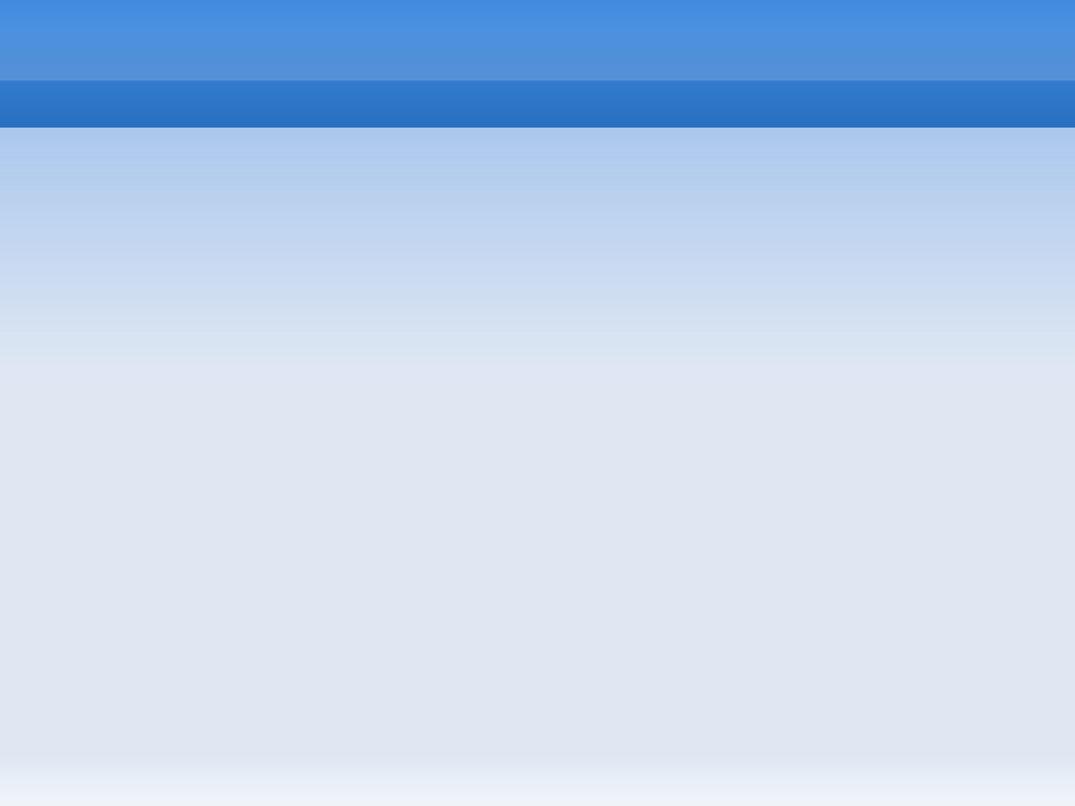
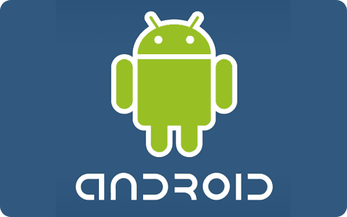
OS Android
Romashko Artyom
Supervision: Chernyakova E.A.

Slide 3
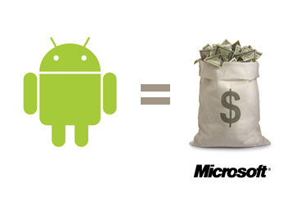
Android (operating system)
Android is a Linux-based operating system designed primarily for
touchscreen mobile devices such as smartphones and tablet computers.
Initially developed by Android, Inc., whom Google financially backed
and later purchased in 2005, Android was unveiled in 2007 along with
the founding of the Open Handset Alliance: a consortium of hardware,
software, and telecommunication companies devoted to advancing open
standards for mobile devices. The first Android-powered phone
was sold in October 2008.

Slide 4
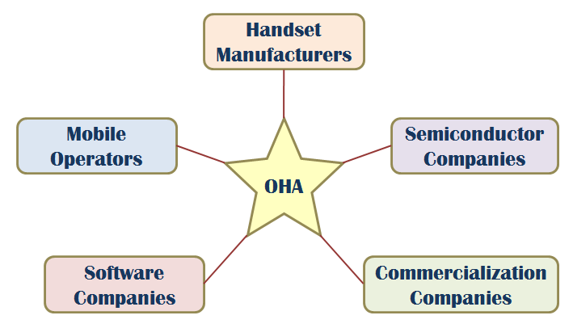
OHA (Open Handset Alliance)
A business alliance consisting of 47 companies to develop open standards for mobile devices

Slide 5
Android (operating system)
Android is open source and Google releases the code under the
Apache License. This open source code and permissive licensing
allows the software to be freely modified and distributed by
device manufacturers, wireless carriers and enthusiast developers.
Additionally, Android has a large community of developers writing
applications ("apps") that extend the functionality of devices,
written primarily in a customized version of the Java programming
language.
In October 2012, there were approximately 700,000 apps
available for Android, and the estimated number of applications
downloaded from Google Play,
Android's primary app store, was 25 billion.

Slide 6
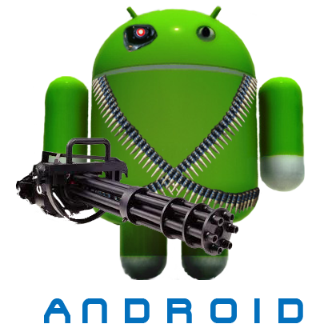
Android (operating system)
These factors have allowed Android to become the world's most
widely used smartphone platform and the software of choice
for technology companies who require a low-cost, customizable,
lightweight operating system for high tech devices without
developing one from scratch. As a result, despite being primarily
designed for phones and tablets, it has seen additional applications
on televisions, games consoles and other electronics.
Android's open nature
has further encouraged a large community of developers
and
enthusiasts to use the open source code as a
for community-driven projects, which add new features
for advanced users or bring Android to
devices which were
officially released running other
operating systems.

Slide 7

Android (operating system)
Android had a worldwide smartphone market share of 75% during the third quarter of 2012, with 500 million devices activated in total and 1.3 million activations per day. However, the operating system's success has made it a target for patent litigation as part of the so-called "smartphone wars" between technology companies.

Slide 8
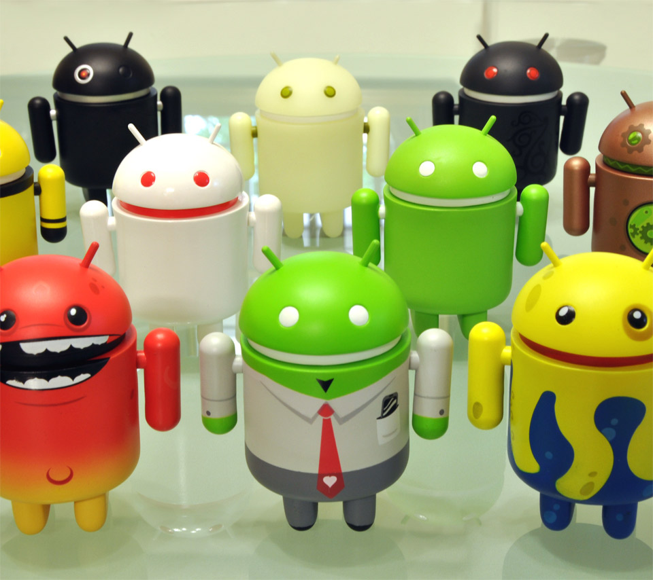
History
Android, Inc. was founded in Palo Alto, California in October 2003 by Andy Rubin (co-founder of Danger), Rich Miner (co-founder of Wildfire Communications, Inc.), Nick Sears (once VP at T-Mobile), and Chris White (headed design and interface development at WebTV) to develop, in Rubin's words "...smarter mobile devices that are more aware of its owner's location and preferences. "Despite the obvious past accomplishments of the founders and early employees, Android Inc. operated secretly, revealing only that it was working on software for mobile phones. That same year, Rubin ran out of money. Steve Perlman, a close friend of Rubin, brought him $10,000 in cash in an envelope and refused a stake in the company.

Slide 9
History
Speculation about Google's intention to enter the mobile communications market continued to build through December 2006. Reports from the BBC and The Wall Street Journal noted that Google wanted its search and applications on mobile phones and it was working hard to deliver that. Print and online media outlets soon reported rumors that Google was developing a Google-branded handset. Some speculated that as Google was defining technical specifications, it was showing prototypes to cell phone manufacturers and network operators. In September 2007, InformationWeek covered an Evalueserve study reporting that Google had filed several patent applications in the area of mobile telephony.
On November 5, 2007, the Open Handset Alliance, a consortium of technology companies including Google, device manufacturers such as HTC and Samsung, wireless carriers such as Sprint Nextel and T-Mobile, and chipset makers such as Qualcomm and Texas Instruments, unveiled itself, with a goal to develop open standards for mobile devices. That day, Android was unveiled as its first product, a mobile device platform built on the Linux kernel version 2.6. The first commercially available phone to run Android was the HTC Dream, released on October 22, 2008.

Slide 10
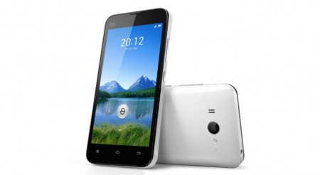
History
Since 2008, Android has seen numerous updates which have incrementally improved the operating system, adding new features and fixing bugs in previous releases. Each major release is named in alphabetical order after a dessert or sugary treat; for example, version 1.5 Cupcake was followed by 1.6 Donut. The latest release is 4.2 Jelly Bean. In 2010, Google launched its Nexus series of devices - a line of smartphones and tablets running the Android operating system, and built by a manufacturer partner. HTC collaborated with Google to release the first Nexus smartphone, the Nexus One. The series has since been updated with newer devices, such as the Galaxy Nexus phone and Nexus 7 tablet, made by Samsung and Asus respectively. Google releases the Nexus phones and tablets to act as their flagship Android devices, demonstrating Android's latest software and hardware features.

Slide 11
Interface
Android's user interface is based on direct manipulation, using touch inputs that loosely correspond to real-world actions, like swiping, tapping, pinching and reverse pinching to manipulate on-screen objects. The response to user input is designed to be immediate and provides a fluid touch interface, often using the vibration capabilities of the device to provide haptic feedback to the user. Internal hardware such as accelerometers, gyroscopes and proximity sensors are used by some applications to respond to additional user actions, for example adjusting the screen from portrait to landscape depending on how the device is oriented, or allowing the user to steer a vehicle in a racing game by rotating the device, simulating control of a steering wheel.
Android devices boot to the homescreen, the primary navigation and information point on the device, which is similar to the desktop found on PCs. Android homescreens are typically made up of app icons and widgets; app icons launch the associated app, whereas widgets display live, auto-updating content such as the weather forecast, the user's email inbox, or a news ticker directly on the homescreen. A homescreen may be made up of several pages that the user can swipe back and forth between, though Android's homescreen interface is heavily customisable, allowing the user to adjust the look and feel of the device to their tastes. Third party apps available on Google Play and other app stores can extensively re-theme the homescreen, and even mimic the look of other operating systems, such as Windows Phone. Most manufacturers, and some wireless carriers, customise the look and feel of their Android devices to differentiate themselves from the competition.

Slide 12
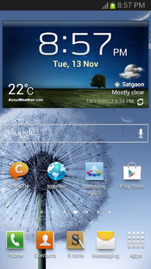
Interface
Present along the top of the screen is a status bar, showing information about the device and its connectivity. This status bar can be "pulled" down to reveal a notification screen where apps display important information or updates, such as a newly received email or SMS text, in a way that doesn't immediately interrupt or inconvenience the user. In early versions of Android these notifications could be tapped to open the relevant app, but recent updates have provided enhanced functionality, such as the ability to call a number back directly from the missed call notification without having to open the dialer app first. Notifications are persistent until read or dismissed by the user.
A Samsung Galaxy Note II's homescreen, showing the status bar, a clock and weather widget, a Google search bar, and several app shortcuts.

Slide 13
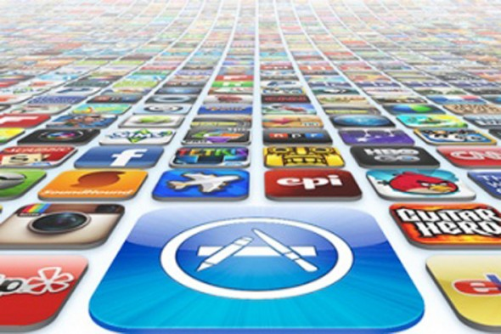
Applications
Android has a growing selection of third party applications, which can be acquired by users either through an app store such as Google Play or the Amazon Appstore, or by downloading and installing the application's APK file from a third-party site. The Play Store application allows users to browse, download and update apps published by Google and third-party developers, and is pre-installed on devices that comply with Google's compatibility requirements. The app filters the list of available applications to those that are compatible with the user's device, and developers may restrict their applications to particular carriers or countries for business reasons. Purchases of unwanted applications can be refunded within 15 minutes of the time of download, and some carriers offer direct carrier billing for Google Play application purchases, where the cost of the application is added to the user's monthly bill. As of September 2012, there were more than 675,000 apps available for Android, and the estimated number of applications downloaded from the Play Store was 25 billion.

Slide 14
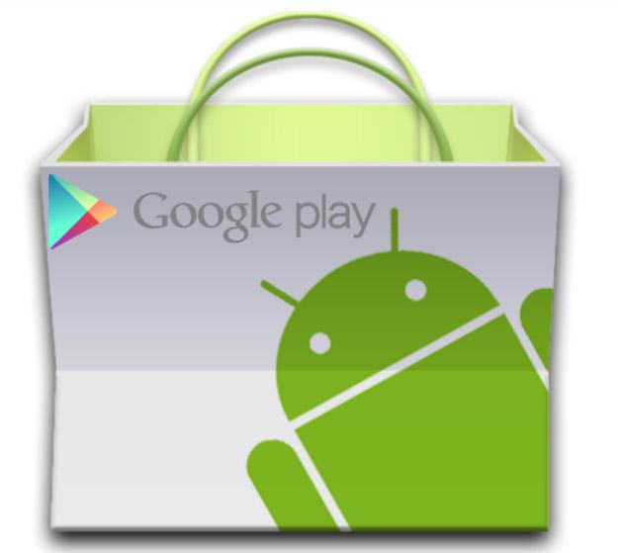
Applications
Applications are developed in the Java language using the Android software development kit (SDK). The SDK includes a comprehensive set of development tools, including a debugger, software libraries, a handset emulator based on QEMU, documentation, sample code, and tutorials. The officially supported integrated development environment (IDE) is Eclipse using the Android Development Tools (ADT) plugin. Other development tools are available, including a Native Development Kit for applications or extensions in C or C++, Google App Inventor, a visual environment for novice programmers, and various cross platform mobile web applications frameworks.
In order to work around limitations on reaching Google services due to Internet censorship in the People's Republic of China, Android devices sold in the PRC are generally customized to use state approved services instead.

Slide 15
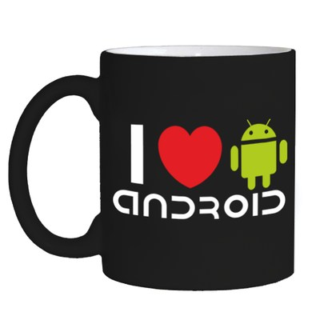
Android
A S/W stack for mobile devices developed and managed by OHA
A free S/W under Apache License
Android
Key Applications
Middleware
Operating System (Linux Kernel 2.6)

Slide 16
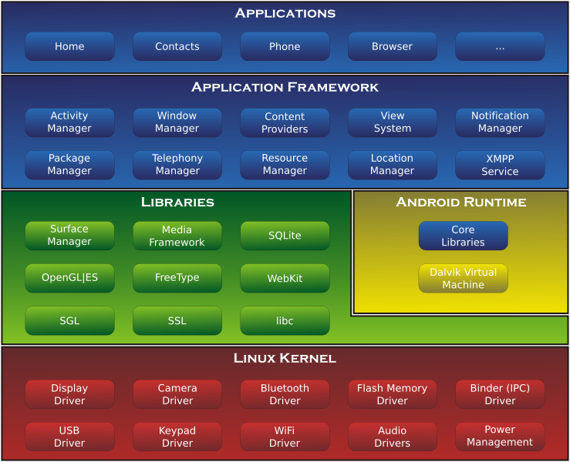
Development

Slide 17
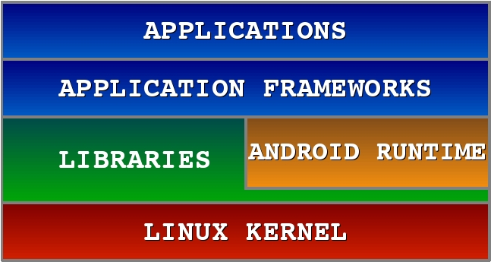
Android Software Stack

Slide 18

Android S/W Stack - Application
Android provides a set of core applications:
  Email Client
  SMS Program
  Calendar
  Maps
  Browser
  Contacts
  Etc
All applications are written using the Java language.

Slide 19
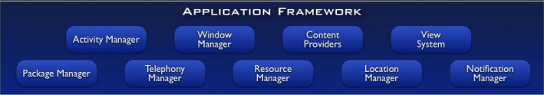
Android S/W Stack – App Framework
Enabling and simplifying the reuse of components
  Developers have full access to the same framework APIs used by the core applications.
  Users are allowed to replace components.

Slide 20
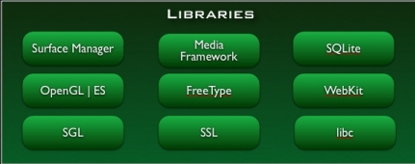
Android S/W Stack - Libraries
Including a set of C/C++ libraries used by components of the Android system
Exposed to developers through the Android application framework

Slide 21
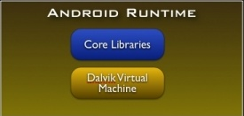
Android S/W Stack - Runtime
Core Libraries
  Providing most of the functionality available in the core libraries of the Java language
  APIs
    Data Structures
    Utilities
    File Access
    Network Access
    Graphics
    Etc

Slide 22
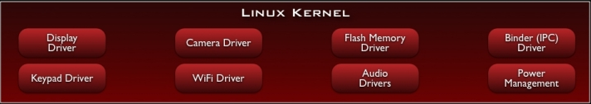
Android S/W Stack – Linux Kernel
Relying on Linux Kernel 2.6 for core system services
  Memory and Process Management
  Network Stack
  Driver Model
  Security
Providing an abstraction layer between the H/W and the rest of
the S/W stack

Slide 23
Memory management
Since Android devices are usually battery-powered, Android is designed to manage memory (RAM) to keep power consumption at a minimum, in contrast to desktop operating systems which generally assume they are connected to unlimited mains electricity. When an Android app is no longer in use, the system will automatically suspend it in memory - while the app is still technically "open," suspended apps consume no resources (e.g. battery power or processing power) and sit idly in the background until needed again. This has the dual benefit of increasing the general responsiveness of Android devices, since apps don't need to be closed and reopened from scratch each time, but also ensuring background apps don't waste power needlessly.
Android manages the apps stored in memory automatically: when memory is low, the system will begin killing apps and processes that have been inactive for a while, in reverse order since they were last used (i.e. oldest first). This process is designed to be invisible to the user, such that users do not need to manage memory or the killing of apps themselves. However, confusion over Android memory management has resulted in third-party task killers becoming popular on the Google Play store; these third-party task killers are generally regarded as doing more harm than good.

Slide 24
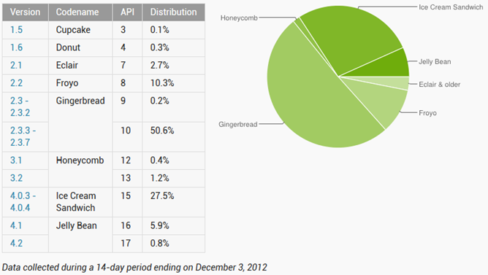
Usage share of Android versions

Slide 25
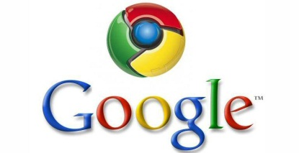
Any Questions ?
www.google.com :P

